Slide 1

Tampa Deep-Sea X-plorers
Boat Bumper Entry
For
OPENWERX
Competition

Slide 2
About Us
Tampa Deep-Sea X-plorers is an LLC in Florida formed for the purpose of competing in the
Shell Ocean Discovery XPRIZE
Ed Larson
Richard Clark
Chuck Begian
Ian Blenke

Slide 3
The Challenge
• Goal 1: Safe transfer of personnel
• Build a system that allows for safe and balanced transport of operator from vessel to target • Passage must be wide enough for single personnel
• Goal 2: Protect bow area from damage
• The bumper must be able to protect bow when impacting target vessels
• Bumper cannot be permanently fixed to bow

Slide 4
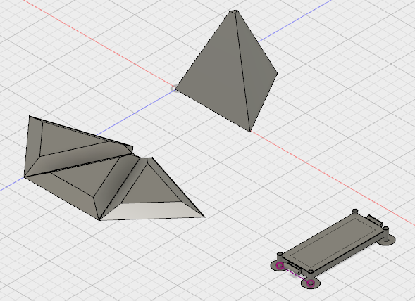
Preliminary Design
Foam Cone

Slide 5
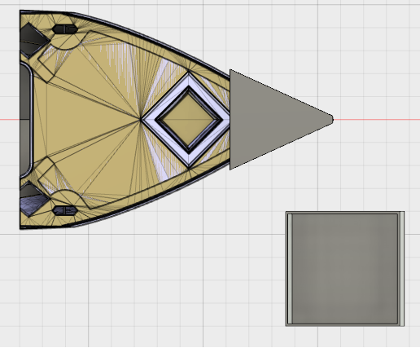
Preliminary Design
Foam Cone

Slide 6
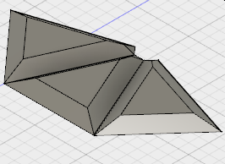
Preliminary Design
The Cone
A perfect pyramid made from identical foam sides pieces.

Slide 7
Preliminary Design
The Cone
Stong, light, flexible and symetrical

Slide 8
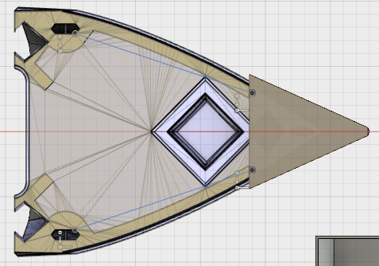
Preliminary Design
The Cone
Secured to boat by lines tied to hard points

Slide 9
Preliminary Design
The Math
5000 lb
A 5000 lb static load applied to the bow

Slide 10
Preliminary Design
The Math
A 5000 lb static load applied to the bow is distributed to all 3 sides of the cone, due to the geometry and symmetry of the shape.
This is equal to about 2000 lb load applied to each face of the pyramid.
This load is distributed across the surface of each face.

Slide 11
Preliminary Design
The Math
5000 lb
10 psi
The load applies about 10 psi pressure on all sides.

Slide 12
Preliminary Design
The Math
1000 lb
Dynamic loads of 1000 lbs become 2 psi distributed.

Slide 13
Preliminary Design
The Cone
3 high density neoprene triangles that can be stored separately and quickly assembled to form the cone.

Slide 14
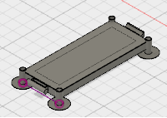
Preliminary Design
The Gangway
18 inch wide, welded steel or aluminum.
40 inches long with modular design with interlocks.
Multiple gangways can be used to extend length.

Slide 15
Preliminary Design
The Gangway
Everything will break down and easily fit in a 24x48x48 space with room to spare.

Slide 16
Summary
The gangway is simple, strong, easily storable.
Modular design allows variable length
The cone is light, strong, and flexible
Modular design for easy assembly
Symmetry of design efficiently distributes loads
Protects the host boat and the target.
Notes:
16

